Slide 1
Using the fx-CG50 for statistics
Task A: Numerical summaries of data
1) This frequency table shows the star rating received by a restaurant over its opening weekend.
Star rating | Frequency
1 | 12
2 | 18
3 | 21
4 | 38
5 | 45
a) What was the mean star rating?
3.64… stars (which rounds to 4)
b) What was the median star rating?
4 stars
2) The frequency table shows the number of bedrooms in different houses within an area of a town.
Bedrooms | Frequency
1 | 20
2 | 93
3 | 54
4 | 33
a) What is the mean number of bedrooms?
2.5 bedrooms (which rounds to 3)
b) What is the median number of bedrooms?
2 bedrooms
3) The time it takes for a sample of pupils to travel to school is collected in this grouped frequency table.
Time taken to travel to school (in minutes) | Frequency (f )
0 < t ≤ 4 | 28
4 < t ≤ 10 | 23
10 < t ≤ 16 | 70
16 < t ≤ 26 | 52
26 < t ≤ 40 | 30
40 < t ≤ 60 | 13
a) What is the estimated mean travel time (to the nearest minute)?
18 minutes
b) What is the estimated median travel time (to the nearest minute)?
13 minutes

Slide 2
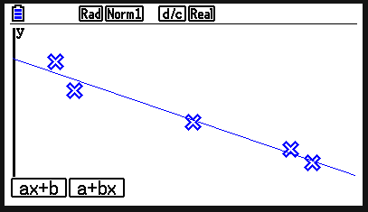
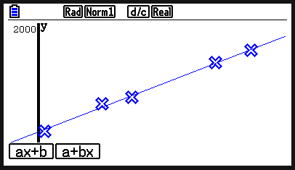
Using the fx-CG50 for statistics
Task B: Graphical representations of data
1) The table shows weather data from Bradford, for five months in 2021.
What does this data suggest about the weather? Justify your answer.
Month | Total rainfall (mm) | Total sunshine (hours)
Feb | 100 | 66
Apr | 16 | 216
Jun | 22 | 173
Aug | 61 | 126
Oct | 93 | 86
There is negative correlation. More rain means less sunshine.
2) Jacob runs a series of long-distance races. For each race, he records his time and the elevation of the course. What does this data suggest about elevation and the time taken? Justify your answer.
elevation (m) | time (s)
51 | 1756
4 | 1644
35 | 1735
115 | 1911
96 | 1870
There is positive correlation. The greater the elevation, the more time it takes to run the course.
Mathematics in Education and Industry
v2.5

